Slide 1
INTERNETWORKING
In this section, we discuss internetworking, connecting networks together to make an internetwork or an internet.
20.<number>

Slide 2
Index
IPv4 header format
ARP, RARP, DHCP, ICMP, IGMP
Routing, data forwarding
Congestion control
20.<number>

Slide 3
Network Layer
Need
  A frame has no routing info.
  DATA LINK layer has no routing info.
  For a router with 3+ NIC’s,
    how to deliver a packet through multiple links.
    How to find a next hop router
Responsibility
  Host-to-host delivery
  For routing packets through the router and switches.
20.<number>

Slide 4

Links between two hosts: hop to hop
20.<number>

Slide 5

Network layer in an internetwork
20.<number>

Slide 6


Network layer at the source, router, and destination
20.<number>

Slide 7
Internet as an L3
Switching at the network layer in the Internet uses the datagram approach to packet switching.
  Use of globally unique address for each packet
Communication at the network layer in the Internet is connectionless.
  Each packet is treated independently by the intermediate routers.
  Packets in a message may travel through different paths.
Why?
20.<number>

Slide 8

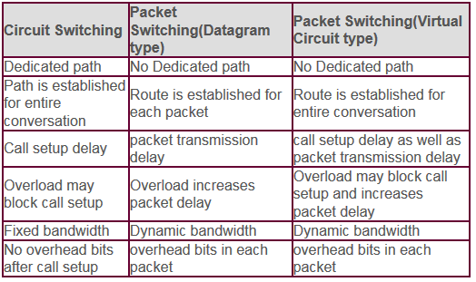
20.<number>

Slide 9
IPV4
The Internet Protocol version 4 (IPv4) is the delivery mechanism used by the TCP/IP protocols.
20.<number>

Slide 10

Position of IPv4 in TCP/IP protocol suite
20.<number>

Slide 11

IPv4 datagram format
20.<number>

Slide 12
IPv4 Header
Variable length: 20-60 byte (multiple of 4)
Contains routing information
20.<number>

Slide 13

IPv4 Format
Version (4-bit): currently 4.
Header length (4-bit): the length of the IP header in 4-byte unit.
Type of Services(TOS):
  This field was not used earlier because of the lack of standard
  DiffServ uses this field for differentiate packet types.
Total length
  to define the total length of the datagram including the header in bytes.
  16-bit number, the maximum IP size is limited to 2¹⁶ bytes, or 64 Kbytes.
20.<number>

Slide 14
IPv4 Format
Identification
  A source node gives a unique ID to each packet.
  Identification, Flags, Fragmentation offset fields are used for fragmentation (will be covered later)
Time to Live (TTL)
  A packet has a limited lifetime in the network to avoid zombie packets.
  Designed to hold a timestamp, and decreased by each router. A packet is discarded by a router if TTL is zero.
  Revised to hold the maximum number of hops the packet can travel thru the network. Each router decrements it by one.
Protocol
  To define payload protocol type
  1 for ICMP
  2 for IGMP
  6 for TCP
  17 for UDP
  89 for OSPF
20.<number>

Slide 15
IPv4 Format
Header checksum
  Refer RFC 1071
  An IP header is slightly modified by each router. At least TTL field.
  The checksum must be re-calculated by routers which is a kind of general computers with more than one network interface.
  The checksum must be efficiently calculated with no need of special hardware.
Source IP address and Destination IP address
Options
  Variable length
  For new protocols
Padding
  To make the header a multiple of 32-bit words
20.<number>

Slide 16
In an IPv4 packet, the value of HLEN is 1000 in binary. How many bytes of options are being carried by this packet?
20.<number>

Slide 17
In an IPv4 packet, the value of HLEN is 1000 in binary. How many bytes of options are being carried by this packet?
Solution
The HLEN value is 8, which means the total number of bytes in the header is 8 × 4, or 32 bytes. The first 20 bytes are the base header, the next 12 bytes are the options.
20.<number>

Slide 18
In an IPv4 packet, the value of HLEN is 5, and the value of the total length field is 0x0028. How many bytes of data are being carried by this packet?
Length of the data = total length – header length
20.<number>

Slide 19
In an IPv4 packet, the value of HLEN is 5, and the value of the total length field is 0x0028. How many bytes of data are being carried by this packet?
Solution
The HLEN value is 5, which means the total number of bytes in the header is 5 × 4, or 20 bytes (no options). The total length is 40 bytes, which means the packet is carrying 20 bytes of data (40 − 20).
20.<number>

Slide 20

MTUs for some networks
20.<number>

Slide 21
Fields for Fragmentation
Identification
  The source host generates the unique ID (Identification + Src addr -> unique identification of packet)
Flags (3-bits)
  Unused bit
  DF bit (Don’t Fragment)
    1 – force the router not to fragment the packet. If the packet length is greater than the MTU, the router will discard the packet and send an error message to the source
  MF bit (More Fragment)
    1 – tell the destination whether or not more fragments follow
Offset (13 bit => 8191 bytes)
  Unit of 8-byte (why?)
  Between the beginning of the packet to be fragmented and the beginning of the fragment
Intelligent Router (Switch) uses these fields for efficiency.
  PPD (Partial Packet Discard)
  EPD (Early Packet Discard)
20.<number>

Slide 22

Fragmentation example
20.<number>

Slide 23

Detailed fragmentation example
20.<number>

Slide 24

Figure 20.13 Example of checksum calculation in IPv4
20.<number>

Slide 25
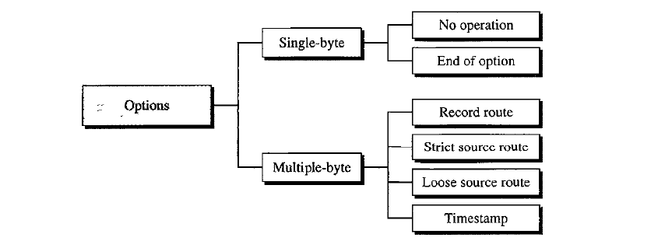
Taxonomy of Header options
Single byte for padding
Record routes : records up to 9 router information
Strict source route: follow the route specified
Loose source route : similar to strict route but can visit other routers also.
Timestamp: records time of datagram processing at router
20.<number>

Slide 26
Thank You
20.<number>

